Slide 1
Probability-Distribution-Q-Q Plot

Slide 2
Random Variables & Distributions
Random variable (RV): Maps outcomes to numbers.
E.g.: X = # of heads in 2 tosses.
PMF / PDF: Probability Mass Function (discrete) / Probability Density Function (continuous).
Distribution: It tells how many values fall within some range, i.e. how is the data distributed
Common Distributions:
Uniform Distribution.
Binomial: Repeated Bernoulli (number of successes).
Bernoulli: 0 or 1 outcome (coin flip).
Normal Distribution

Slide 3
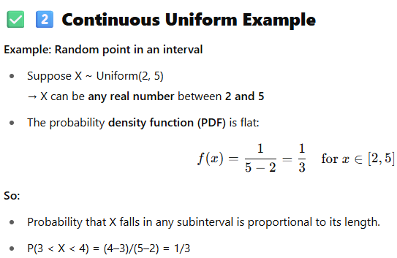
What is the Uniform Distribution?
A Uniform Distribution is the simplest probability distribution:
Every outcome is equally likely within a given range.
Two main types: 1. Discrete Uniform — finite set of equally likely values 2. Continuous Uniform — any value in an interval is equally likely
Discrete Uniform Example
Example: Rolling a fair die
Outcomes: {1, 2, 3, 4, 5, 6}
Each number has probability 1/6
So, P(X = k) = 1/6 for k ∈ {1,2,3,4,5,6}
Key: A dice roll is the classic discrete uniform — all sides equally likely.

Slide 4
Probability (p2.1)
Example: Bernoulli Distribution
A Bernoulli distribution models a single trial with only two outcomes:
Success (1) with probability p
Failure (0) with probability 1–p
Example:
You flip a single fair coin:
X = 1 if Heads
X = 0 if Tails
P(X = 1) = 0.5, P(X = 0) = 0.5
Key Point: Bernoulli is ONE trial, ONE outcome.
Example: Binomial Distribution
A Binomial distribution models the total number of successes in n independent Bernoulli trials with the same probability p.
Example:
You flip a fair coin 10 times.
Let Y = number of Heads in 10 flips.
Then Y ~ Binomial(n = 10, p = 0.5)
Possible values: Y = 0, 1, 2, ..., 10
Key Point: Binomial is many Bernoulli trials, counting total successes.
Aspect | Bernoulli | Binomial
Trials | 1 | n
Outcomes | 0 or 1 | 0 to n
Example | One coin flip | Ten coin flips
What it models | Success/failure in 1 trial | Number of successes in n trials

Slide 5
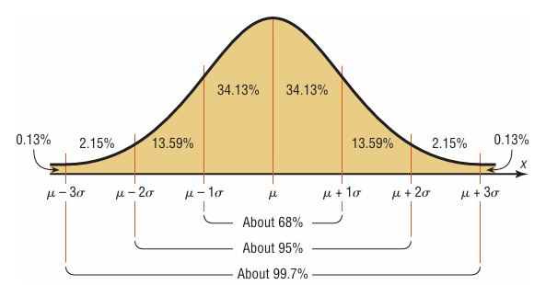
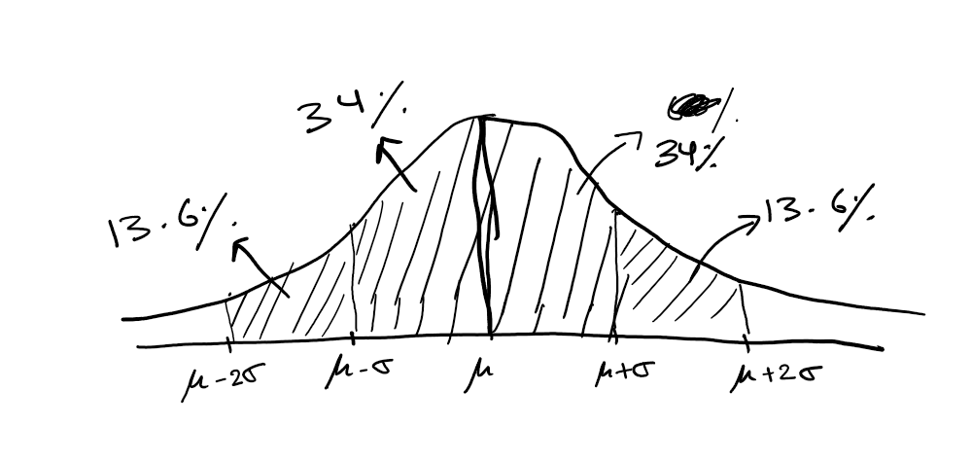
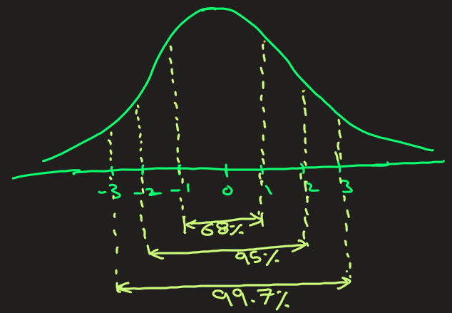
Probability (p2.2)
Key Properties
Mean = median = mode.
About 68% of data falls within 1 standard deviation (σ).
About 95% of data falls within 2 standard deviation (σ).
About 99.7% of data falls within 3 standard deviation (σ).
(This is the famous Empirical Rule)
What is the Normal Distribution?
Also called Gaussian distribution or the bell curve.
It’s a continuous probability distribution.
Symmetric about its mean (μ).
Fully described by mean (μ) and standard deviation (σ).
Many natural phenomena follow it (heights, test scores, measurement errors).

Slide 6















Example: Heights
Example Scenario: Suppose human heights are normally distributed:
Mean height (μ) = 170 cm
Standard deviation (σ) = 10 cm
This is determined from taking random samples from a population
What does this mean?
Most people’s height is around 170 cm.
About 68% of people have heights between 170-10=160 cm and 170+10=180 cm.
About 95% are between 170-20=150 cm and 170+20=190 cm.
It’s very unlikely (<1%) for someone to be shorter than 140 cm or taller than 200 cm.

Slide 7






















Example: Assuming that peoples height is normally distributed, with μ = 170 cm and σ = 10 cm.
What is the probability that a randomly chosen person ht < 180
What is the probability that a randomly chosen person ht > 180
1) Solution: The question is to find P(ht < 180)
Step1: Find z-score
Z = (X – μ)/ σ = (180-170)/10 = 1
Step2: Now the above question changes to find P(Z < 1)
Look up Z=1 in standard normal tables:
P( Z < 1) = 0.8413 (from table)
So, 84.13% of people height is less than 180 cm
2) Solution: The question is to find P(ht > 180)
Step1: Find z-score
Z = (X – μ)/ σ = (180-170)/10 = 1
Step2: Now the above question changes to find P(Z > 1)
Look up Z=1 in standard normal tables:
P( Z < 1) = 0.8413 (from table)
P(Z > 1) = 1 – P(Z < 1) = 1 - 0.8413 = 0.1587
So, 15.87% of people height is greater than 180 cm

Slide 8
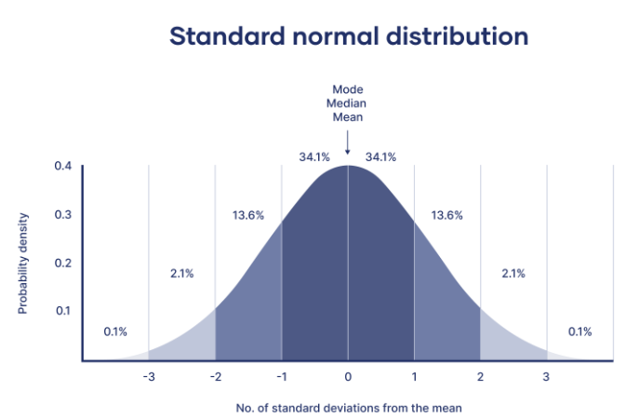
(OPTIONAL)Normal Distribution
A normal distribution, also known as a Gaussian distribution or bell curve, is a symmetrical probability distribution where most data points cluster around the mean, with values farther from the mean occurring less frequently. This distribution is commonly used to model phenomena like heights,etc
Key Characteristics of a Normal Distribution:
Symmetry: The distribution is symmetrical around the mean, with the right side of the center mirroring the left.
Unimodal: It has only one peak, representing the most frequent data value.
Asymptotic Tails: The tails of the curve extend infinitely but never quite touch the x-axis.
Mean, Median, and Mode: These three measures of central tendency are all equal in a normal distribution.
Area Under the Curve: The total area under the curve represents 1, and the area under the curve corresponds to probabilities.
Empirical Rule (68-95-99.7 Rule): Approximately 68% of the data falls within one standard deviation of the mean, 95% within two standard deviations, and 99.7% within three standard deviations.

Slide 9
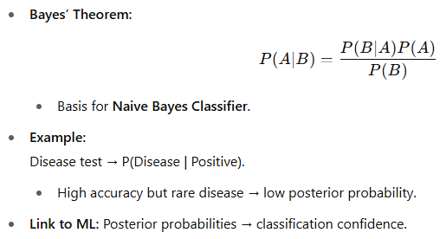
Probability (p3)
Expectation & Variance
Expected value (mean): E[X] = Σ x · P(X=x)
Variance: Var(X) = E[(X – μ)²] → Measures spread / uncertainty.
Example: Toss coin: X = 1 if Head, 0 if Tail. E[X] = 0.5, Var(X) = 0.25.

Slide 10
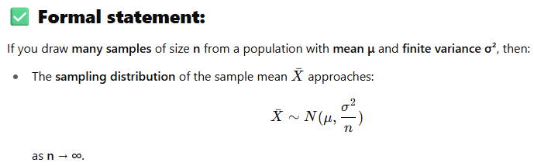





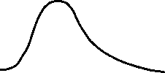

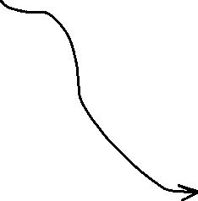
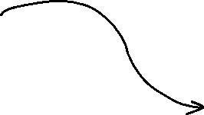
Probability (p4)
What is the Central Limit Theorem (CLT)?
In simple terms: The Central Limit Theorem says that no matter what the shape of the original population distribution is, the distribution of the sample means will:
Approximate a Normal Distribution
As the sample size (n) gets larger
Key idea:
The population can be anything: skewed, uniform, bimodal, weird shape.
If you randomly sample from it repeatedly and calculate the mean each time,
Then the distribution of those means will tend toward a normal distribution.

Slide 11
Probability (p5)
Example:
Suppose the population is daily spending by customers at a store:
It’s highly skewed because a few people spend a LOT.
Mean daily spending: $50, variance: known.
Now:
Take 1 random customer → that spending is not normal.
But take a sample of 100 customers, find the average spending → that average is nearly normally distributed.
If you repeat this process (many samples of 100), the histogram of those averages will look bell-shaped, centered at the true mean ($50).

Slide 12
Key Points
The quantile-quantile( q-q plot) plot is a graphical method for determining if a dataset follows a certain probability distribution or whether two samples of data came from the same population or not. Q-Q plots are particularly useful for assessing whether a dataset is normally distributed or if it follows some other known distribution
They are commonly used in statistics, data analysis, and quality control to check assumptions

